Slide 1
Understanding Customer Bank Churn
Keegan Nair
Notes:
Hi My name is Keegan and today I will be present my project Understanding Customer Bank Churn.

Slide 2
Introduction
Project Aim: Identify key factors influencing churn, and provide actionable recommendations to improve customer retention.
Technologies Used:
Python,
MySQL
Tableau.
Notes:
Objective: This project aims to analyze customer churn in a bank, identify key factors influencing churn, and provide actionable recommendations to improve customer retention.
Overview: Using a dataset of 10,000 bank customers, we employed Python for data processing and cleaning, MySQL for data exploration and Tableau for visualization. Our analysis focused on demographics, account details, and customer activity to uncover insights and drive data-driven decisions.

Slide 3
Key Objectives
Why do customers leave the bank and What are the primary factors influencing churn?
How can the bank reduce churn and improve customer retention?
Notes:
Some of the key objectives we wanted to solve was:
Why do customers leave the bank?
What are the primary factors influencing churn?
How can the bank reduce churn and improve customer retention?

Slide 4
About the Dataset
Dataset info:
10,000 Customer records with 14 columns related to demographics, account details, and customer activity.
Originated from Kaggle
Notes:
The dataset contains 10,000 customer records with 14 Columns related to demographics, account details, and customer activity.

Slide 5
Data processing and cleaning
Step 1: Load & Explore Data
Step 2: Handle Missing & Incorrect Data
Step 3: Convert Data Types & Standardize Formatting
Step 4: Load Cleaned Data into MySQL
Notes:
Data and Processing
Step 1: Load & Explore initial Data
SQL: Imported CSV into MySQL database
Python (pandas): Explored data with .info(), .describe(), and .head()
Step 2: Handle Missing & Incorrect Data
Missing Values: Filled using mean (numerical) or mode (categorical)
Zeros in Salary/Balance: Replaced with median if 0 meant missing data
Duplicates: Removed using DROP DUPLICATES
Step 3: Convert Data Types & Standardize Formatting
Converted categorical variables (e.g., Gender, Geography) into consistent format
Changed Age, CreditScore, Salary to numeric values where needed
Step 4: Load Cleaned Data into MySQL
Connection: Used pymysql and .env file for secure database connection
Table Creation: Created table structure in MySQL
Data Insertion: Inserted cleaned data into MySQL database

Slide 6
Exploratory Analysis With SQL
Exploration topics:
Overall Churn rate
Churn by Geography
Impact of age on churn
Customer Products

Slide 7
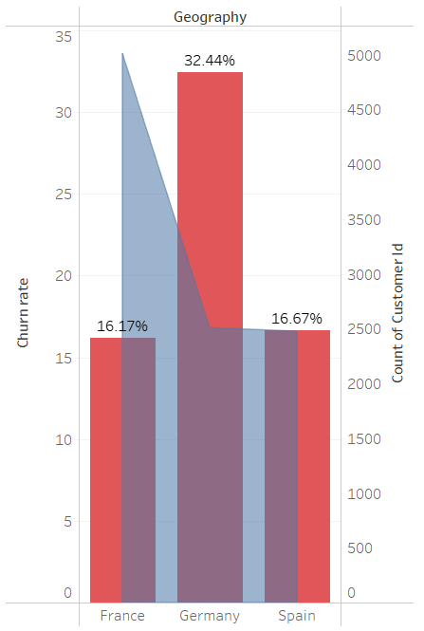

Overall Churn Rate & Geography
Overall churn 20.38%
Germany had the highest rate at 32%
Potential reasons
Different policies in Germany
Customer dissatisfaction in that region.
Notes:
A. Overall Churn Rate
📌 Finding:
The overall churn rate is 20.38%, meaning approximately 2,038 customers left the bank.
B. Churn by Geography
📌 Finding:
Germany has the highest churn rate (32.4%), which is nearly twice the rate of France and Spain. Despite Germany having less than half customer records.
🔹 Possible Reasons:
Different banking policies or fees in Germany.
Customer dissatisfaction in that region.
📌 Recommendation:
Investigate customer complaints in Germany and improve service offerings.

Slide 8
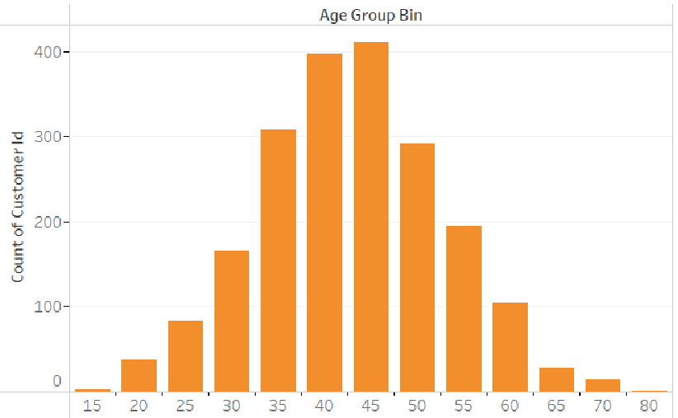
Age Distribution For Customers
Middle aged customers churn the most
Potential reasons
Customers may be switching for better deals
Older customers have higher loyalty due to their tenure.
Notes:
Insights from the Age Churn Rate Graph:
Churn Rates Peaks at Ages 40-45 The highest number of churned customers fall within the 40-45 age group, followed closely by 35-40.
This suggests that middle-aged customers (especially in their 40s) are the most likely to leave.
Lower Churn for Young and Older Customers
Young customers (under 30) churn less, possibly because they have fewer banking commitments or are just starting their financial journey.
Customers over 55 also churn less, likely due to long-term banking relationships and financial stability.
Potential Reasons for High Churn in Middle Age (35-45)
Financial Pressure: Customers in this range may be making major financial decisions (e.g., mortgages, family expenses) and might switch banks for better deals.
Career Transitions: Job changes or relocations could lead them to switch banks.
Dissatisfaction with Services: They might be looking for better investment or loan options.
Recommendations:
✅ Targeted Retention Strategies for 35-45 Age Group
Offer personalized financial plans, mortgage deals, or investment incentives.
Improve customer service and engagement for middle-aged customers.
✅ Loyalty Programs for High-Risk Age Groups
Introduce exclusive banking benefits for customers aged 35-45 to retain them.
✅ Retain New Customers:
Offer welcome bonuses, financial planning assistance, and onboarding benefits.
Educate them about long-term advantages of staying with the bank.
Key Insights from Tenure in Churn Analysis:
Longer Tenure = Higher Loyalty
Customers who have been with the bank for many years are less likely to churn.
They have built trust with the bank and may have multiple financial products, making switching harder.
Shorter Tenure = Higher Churn Risk
Newer customers (e.g., less than 2 years) are more likely to leave.
They may still be exploring different banks or be dissatisfied with initial services.
If they only have one product, they have fewer reasons to stay.
Mid-Tenure (3-6 years) Customers Can Be Unstable
Some mid-tenure customers may churn if they don't see continued value from the bank.
Competitors offering better interest rates or rewards could lure them away.

Slide 9
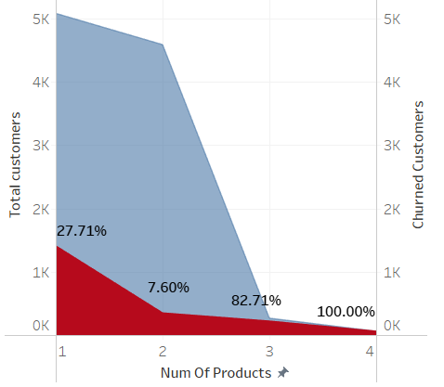
Customer Products
Customers with 2 products churn the least 8%
Customers with 3+ products churn rate alarmingly high
Potential reasons
Dissatisfaction, aggressive cross-selling, or financial strain
Notes:
Churn by Products Held
Key Takeaways:
✅ Customers with 2 products are the most stable – they churn the least. ❌ Customers with 3+ products churn at alarmingly high rates – this could indicate dissatisfaction, aggressive cross-selling, or financial strain.
Recommended Actions:
Encourage customers with only one product to adopt a second one (e.g., if they only have a checking account, offer them a savings account).
Investigate why customers with 3+ products are leaving. Are they being sold products they don’t need? Are fees or complexities driving them away?
Offer personalized financial guidance to customers with multiple products to ensure they’re getting value from them.
Taking a closer look At products held
Customers with Only One Product (NumOfProducts = 1)
Average Age: 39.67
Total Customers: 5,084
Churn Rate: 27.71%
Insight: These customers churn at a moderate rate, indicating they may not feel fully engaged with the bank.
Customers with Two Products (NumOfProducts = 2)
Average Age: 37.75
Total Customers: 4,590
Churn Rate: 7.60%
Insight: This group has the lowest churn rate, suggesting that customers with at least two products feel more committed to staying.
Customers with Three Products (NumOfProducts = 3)
Average Age: 43.20
Total Customers: 266
Churn Rate: 82.71%
Insight: A very high churn rate, which is unexpected. This could indicate that customers with three products might have been oversold financial products or have experienced dissatisfaction.
Customers with Four Products (NumOfProducts = 4)
Average Age: 45.68
Total Customers: 60
Churn Rate: 100%
Insight: Every customer in this group churned. This strongly suggests that customers with too many products might be feeling overwhelmed, or they may be high-value customers who left for better financial services elsewhere.
Key Takeaways:
✅ Customers with 2 products are the most stable – they churn the least. ❌ Customers with 3+ products churn at alarmingly high rates – this could indicate dissatisfaction, aggressive cross-selling, or financial strain.
Recommended Actions:
Encourage customers with only one product to adopt a second one (e.g., if they only have a checking account, offer them a savings account).
Investigate why customers with 3+ products are leaving. Are they being sold products they don’t need? Are fees or complexities driving them away?
Offer personalized financial guidance to customers with multiple products to ensure they’re getting value from them.

Slide 10
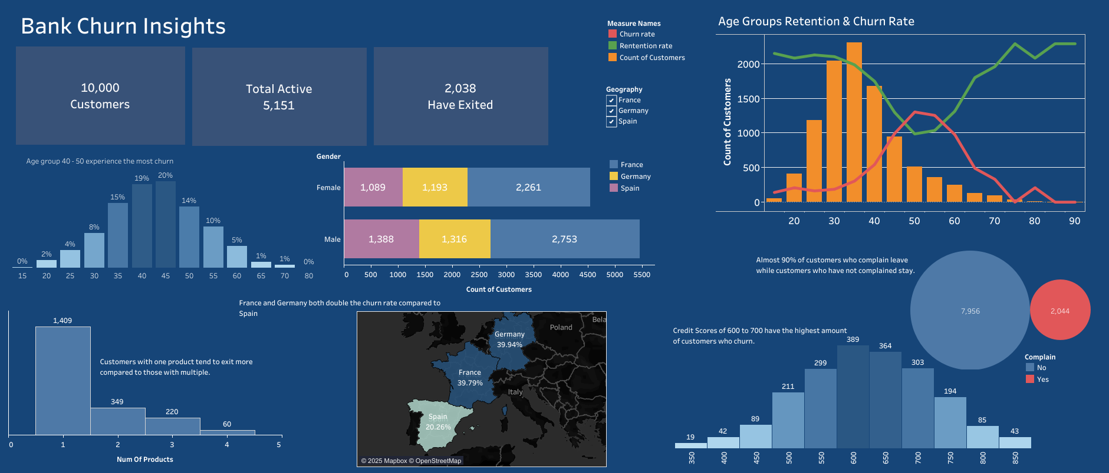
Data Visualisation Tableau
Viz here
Notes:
Here is a full visualisation of the findings
What Your Dashboard Does Well:
✔ High-Level Metrics: Shows total customers, active customers, and churned customers, giving a clear overview. ✔ Churn Breakdown by Age & Gender: Helps identify which groups are most at risk. ✔ Product Ownership & Churn: Highlights the relationship between the number of products and churn rate. ✔ Geographical Insights: Shows churn differences by country. ✔ Customer Complaints Impact: The pie chart clearly shows that most customers who complain churn.

Slide 11
Recommendations
Target High-Churn Regions (Germany)
Improve Retention for Middle aged
Engage Inactive Customers
Promote Multi-Product Usage
Notes:
🔹 High Churn Rate in Germany → Targeted customer retention strategies. Further investigation is needed to Look into why Germany has such a high churn rate compared to other countries.
🔹 Younger customers churn more → Offer loyalty programs for young professionals./ Introduce exclusive banking benefits for customers aged 35-45 to retain them as they are high risk and most likely to leave.
🔹 Inactive members leave despite high balance → Improve engagement & personalized services./ Implement customer engagement strategies (e.g., personalized product offers, reward programs for active members).
Offer incentives for customers to use banking services more frequently
🔹 Credit Score plays a role in churn → Provide financial advisory & tailored loan offers.
🔹 More products over 3+ → Higher churn → Improve complaint resolution processes. / Encourage customers with one product to adopt a second one, as customers with only 2 products tend to churn less. And for customers with 3 to 4 products, more investigation would be needed to find out why they churn at such a high rate.
Encourage customers with only one product to adopt a second one (e.g., if they only have a checking account, offer them a savings account).
Investigate why customers with 3+ products are leaving. Are they being sold products they don’t need? Are fees or complexities driving them away?
A. Target High-Churn Regions (Germany)
Investigate customer dissatisfaction reasons (e.g., fees, service quality).
Offer Germany-specific retention programs (discounted services, improved support).
🔹 B. Improve Retention for Younger Customers
Create personalized banking products for young customers.
Offer loyalty rewards for long-term banking relationships.
🔹 C. Engage Inactive Customers
Send personalized engagement emails.
Offer bonus interest rates or cashback incentives for active transactions.
🔹 E. Promote Multi-Product Usage
Encourage customers to use two to increase loyalty.
Bundle savings, credit, and investment options into attractive packages.

Slide 12
Conclusion
Key findings - Middle aged customers, inactive and customers with 3+ products.
Germany Has highest Churn
Implement recommendations
Notes:
Address Any Potential Bias or Data Limitations
Were there any data issues (e.g., missing values, imbalanced data, unknown factors)?
Example: “The dataset doesn’t tell us if customers were contacted before they left, so churn reasons might be deeper than just the metrics shown.”
Data for each region is not equal, eg; germany having the highest churn rate but they have less customers in total. And france has less churn rate than germany but similar amount of individuals who have left compare to germany despite having the most customers at 4200.

Slide 13
Whole presentation needs to be under 5 min
Refer to tips doc
Maybe add table of contents? If enough time
Notes:
https://docs.google.com/document/d/1U6sKxf8Vb6wo288OP6y98GrVuYhwgnkJCr0iBjwGbZM/edit?tab=t.0
30 secs present purpose/objective project
What did you do? 2min
What are you recommending? 2min

